Slide 1
CrowSoft Project Presentation
Charles Aylward

Slide 2
Code Created - Solution
Web application access via a web browser
Customer Register and Login
Admin users to manage all users and allocate roles
Admin access/edit detailed Information
System calculates building cost analysis and display costing to the customer
Admin to manage costs exceed €1 million.

Slide 3
Code Created - Technical
Programming Language: C#, JavaScript and HTML
IDE: Visual Studio Code
Framework: .Net Core 2.2
Supporting Platforms: Windows, Linux, MacOS
Pattern: MVC (Model View Controller)
Type App: ASP.NET MVC Web Application includes bootstrapping
Database: MySQL
Security
Authentication: Token Based, Password hash (PBKDF2 algorithm with HMAC-SHA256, 128-bit salt, 256-bit subkey, and 10,000 iterations)
Authorization: Role-based Authorization
Hosting Server: Linux Ubuntu 16.04 (using Apache as reverse proxy)
Performance Tests: wrk Performance Tool (Open-source)
Coding Standards Documentation Completed

Slide 4
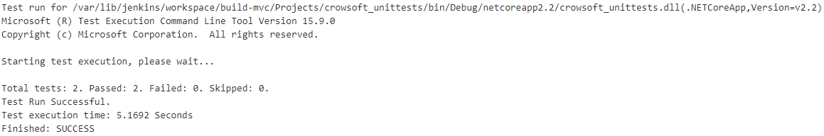
Unit Testing
Nunit for .Net Framework
Testing Controllers Actions (CRUD)
Automated on Jenkins Pipeline
Example:

Slide 5
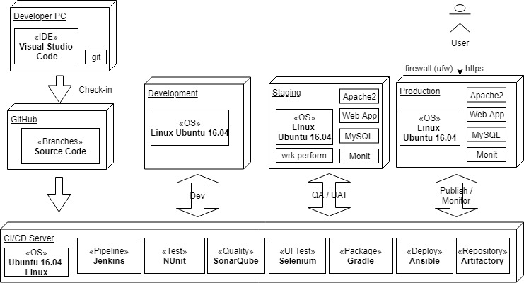
Staging/Production Environments

Slide 6
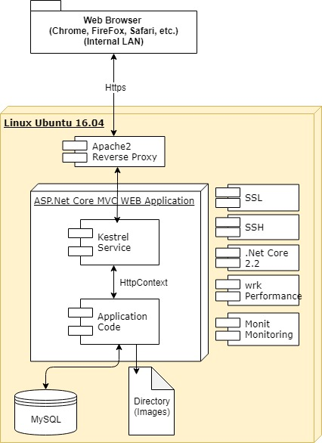
Environments - Technology Stack

